Slide 1

CHAVILION
Parametric Design of Transformable Structures
MA of Architectural Engineering - MA1
Group 6
2020-2021

Slide 2
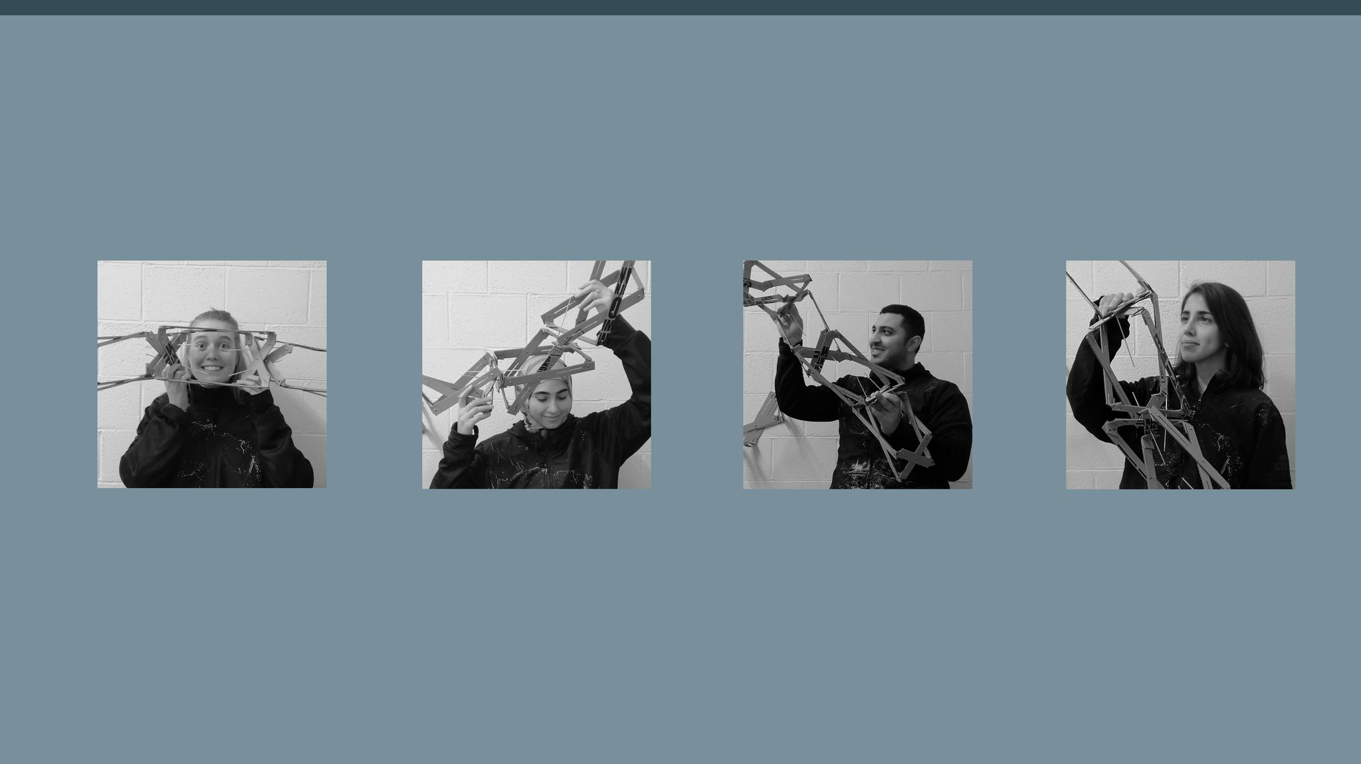
Pauline Harou
Razan Atwi
Ahmed Roshdy
Hana Taherazar

Slide 3

Concept
Deployability
Multi-use
Responsiveness
Main unit
stand-alone function
kit-of -parts system
Pavilion

Slide 4
Concept
Responsiveness
Main unit
stand-alone function
kit-of -parts system
Pavilion

Slide 5
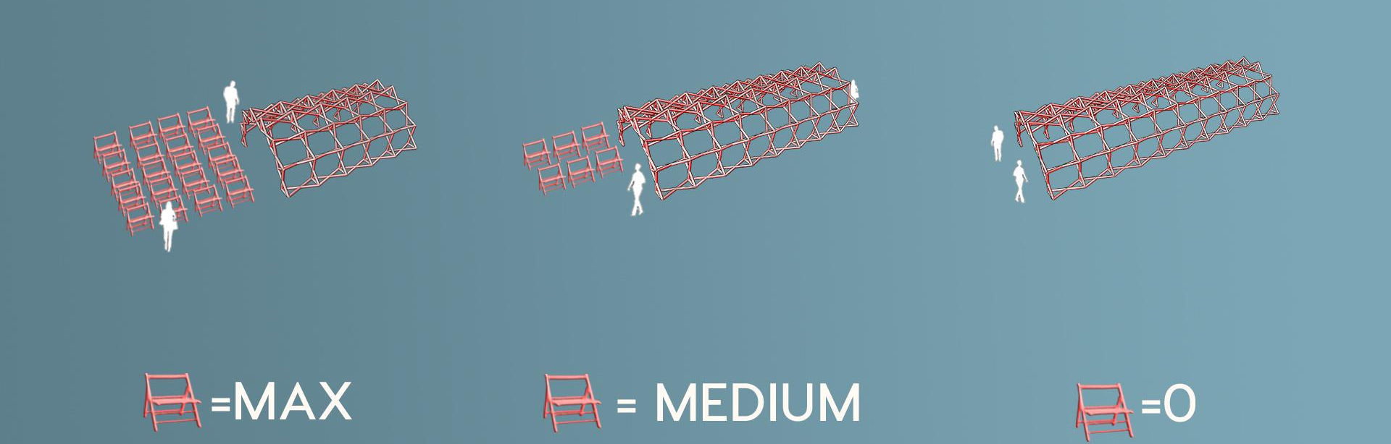
Concept
indoor

Slide 6


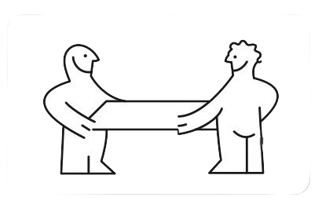
Goals and expected result
Combining SIMPLE existing ideas into a more functional system.
Sustainable usage
Market-chance
Joyful experience
Implementing a dynamic transformation relative to its FUNCTION

Slide 7
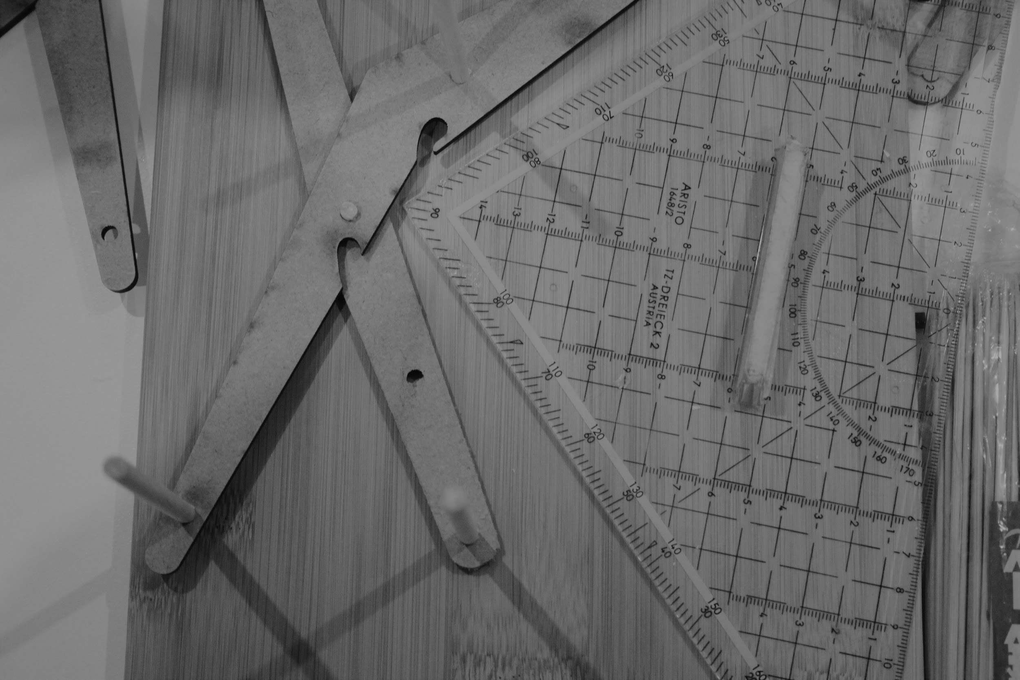
DESIGN PROGRESS

Slide 8
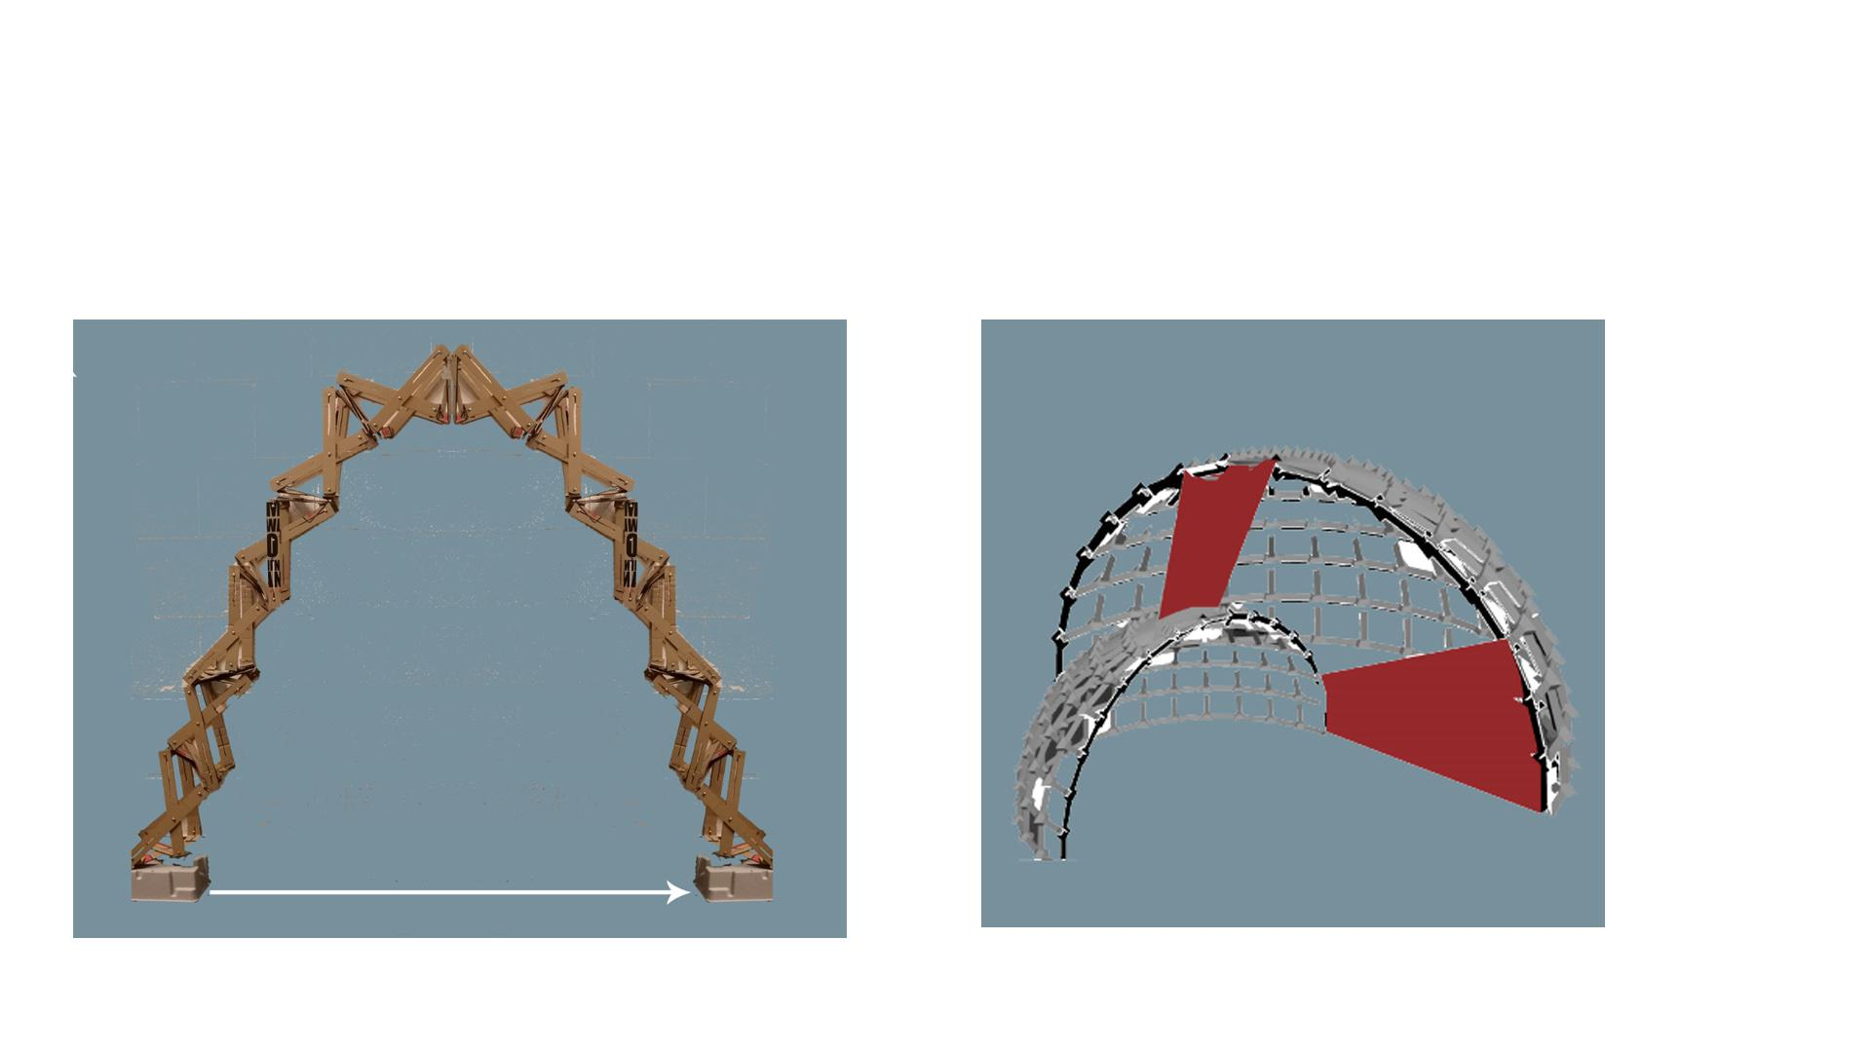
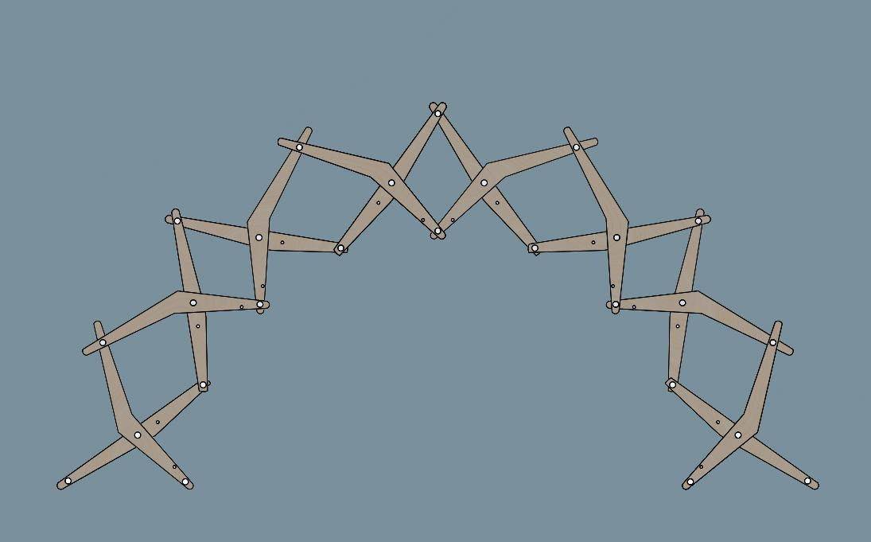
How did the design evolve?

Slide 9
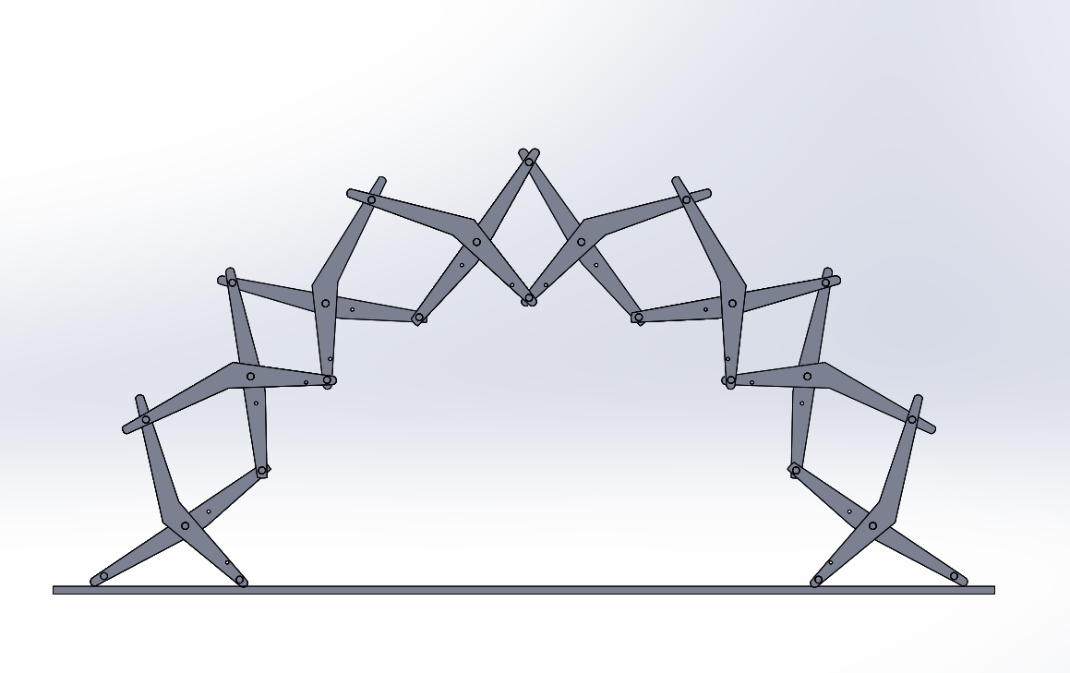

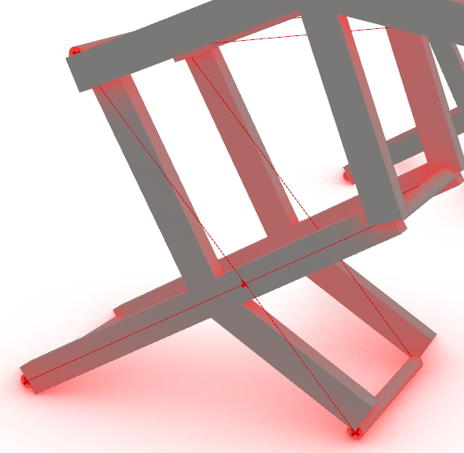


How did the design evolve? (Design process)
Too many variables !
One solution
Main dimensional aspects of the units
First arm of scissor structure / second arm of scissor structure / height of the arch / ratio of chair ...
Model structural testing and simulation analysis
Final design
Testing the kit of parts system
Chair design process

Slide 10
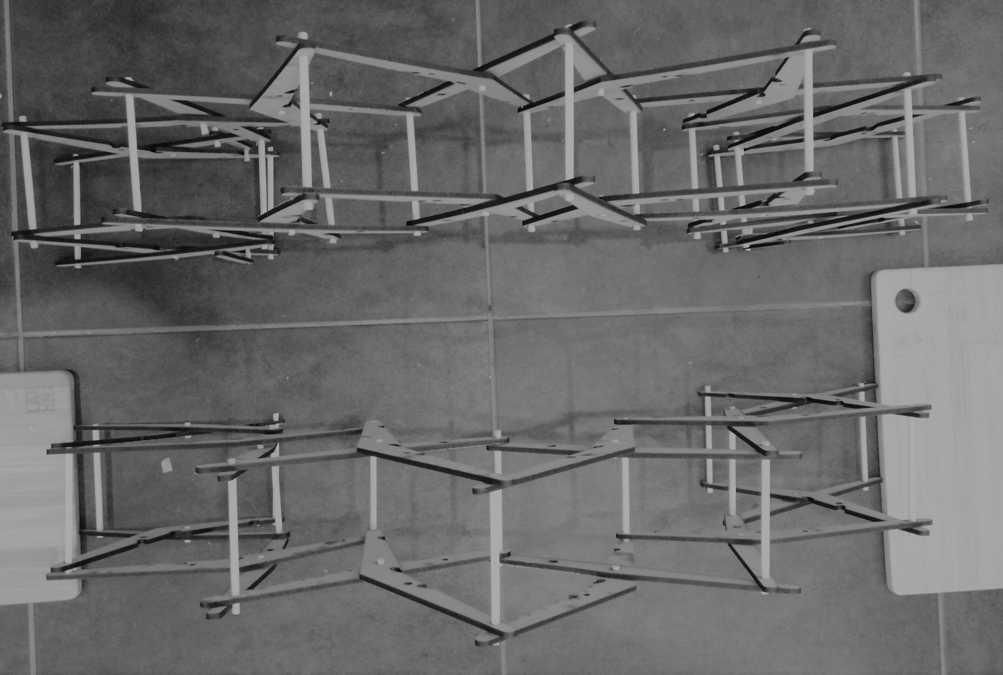
FUNCTIONS AND TRANSFORMABILITY

Slide 11
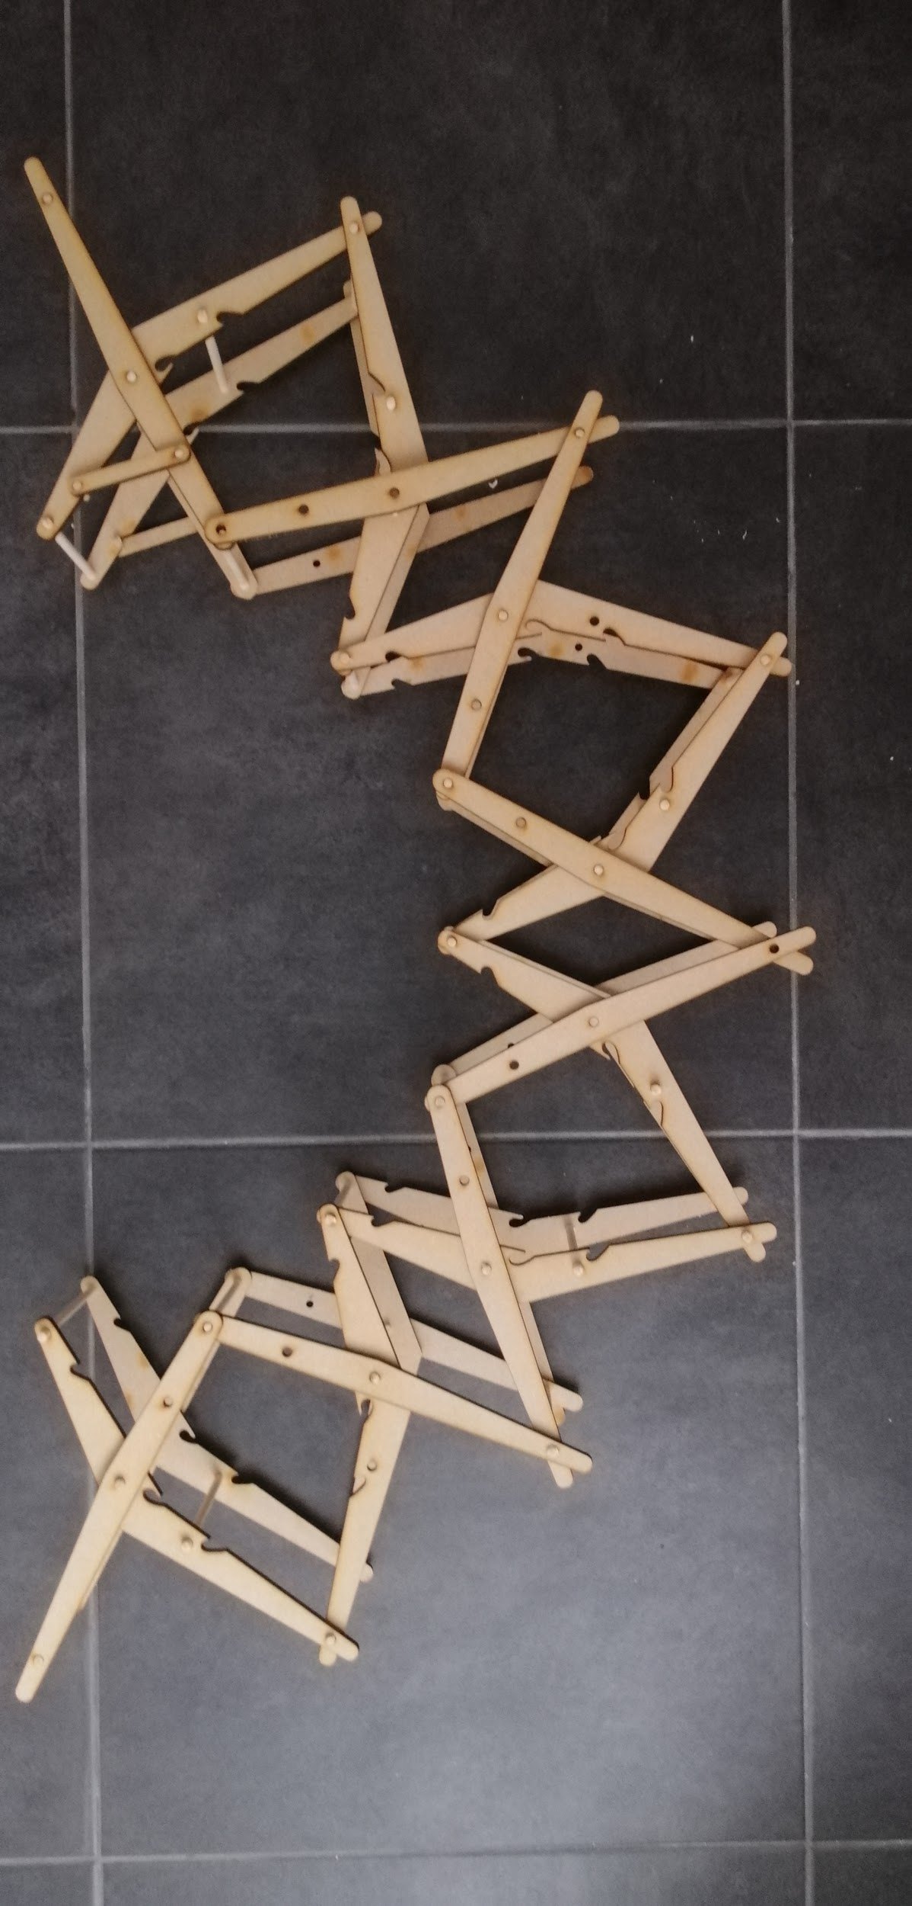
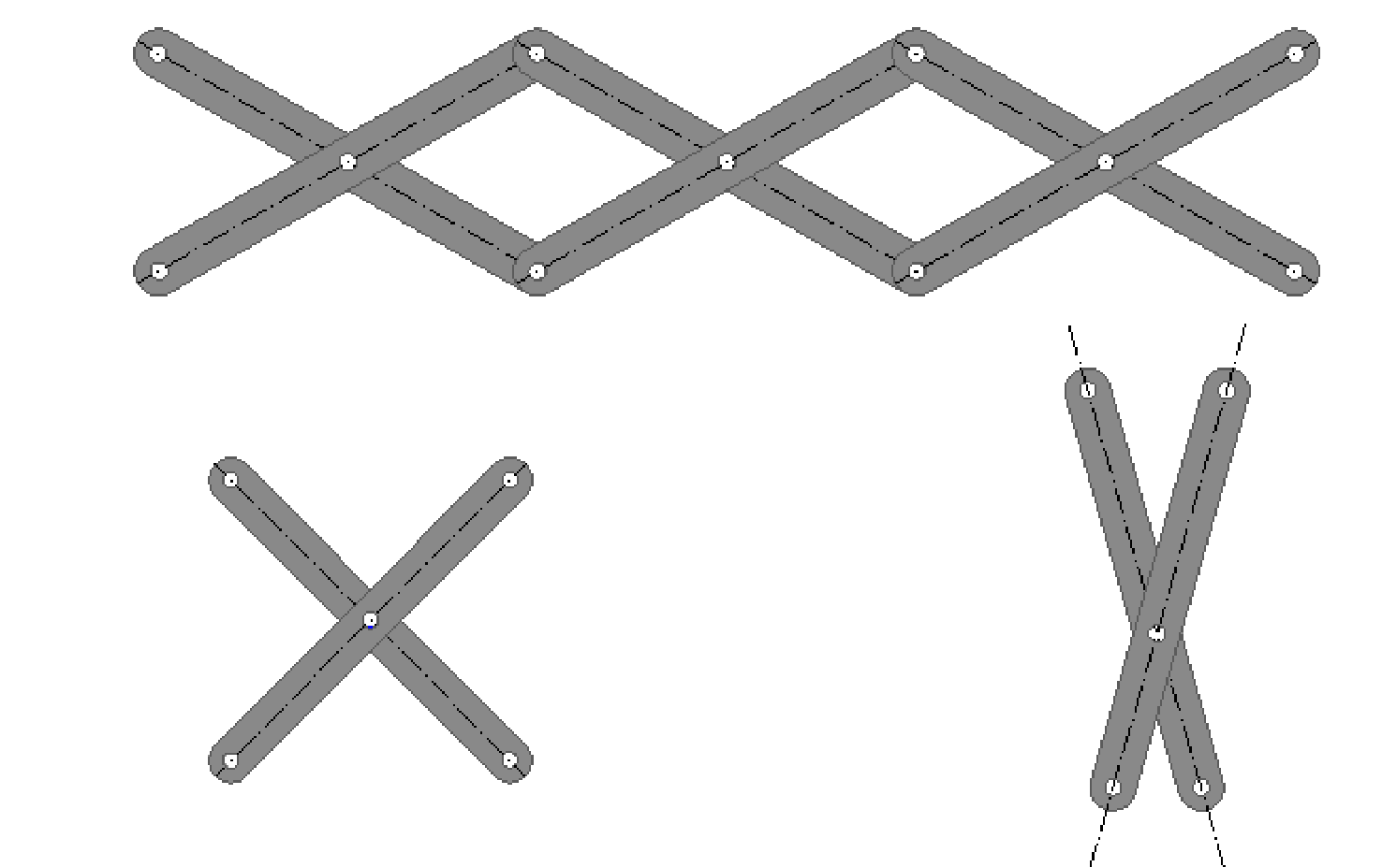
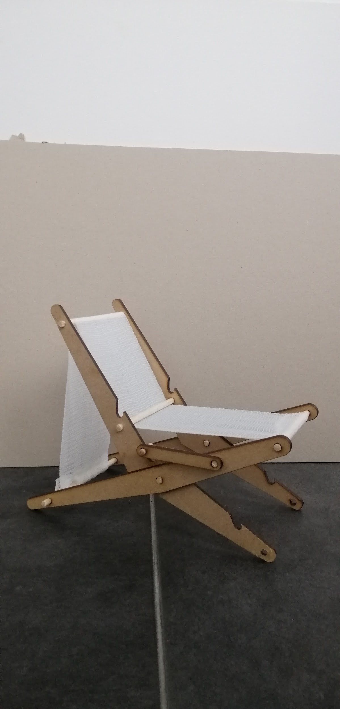
Functions and transformability
From a scissor structure to a chair then a pavilion
Polar scissors
Main unit
The system

Slide 12
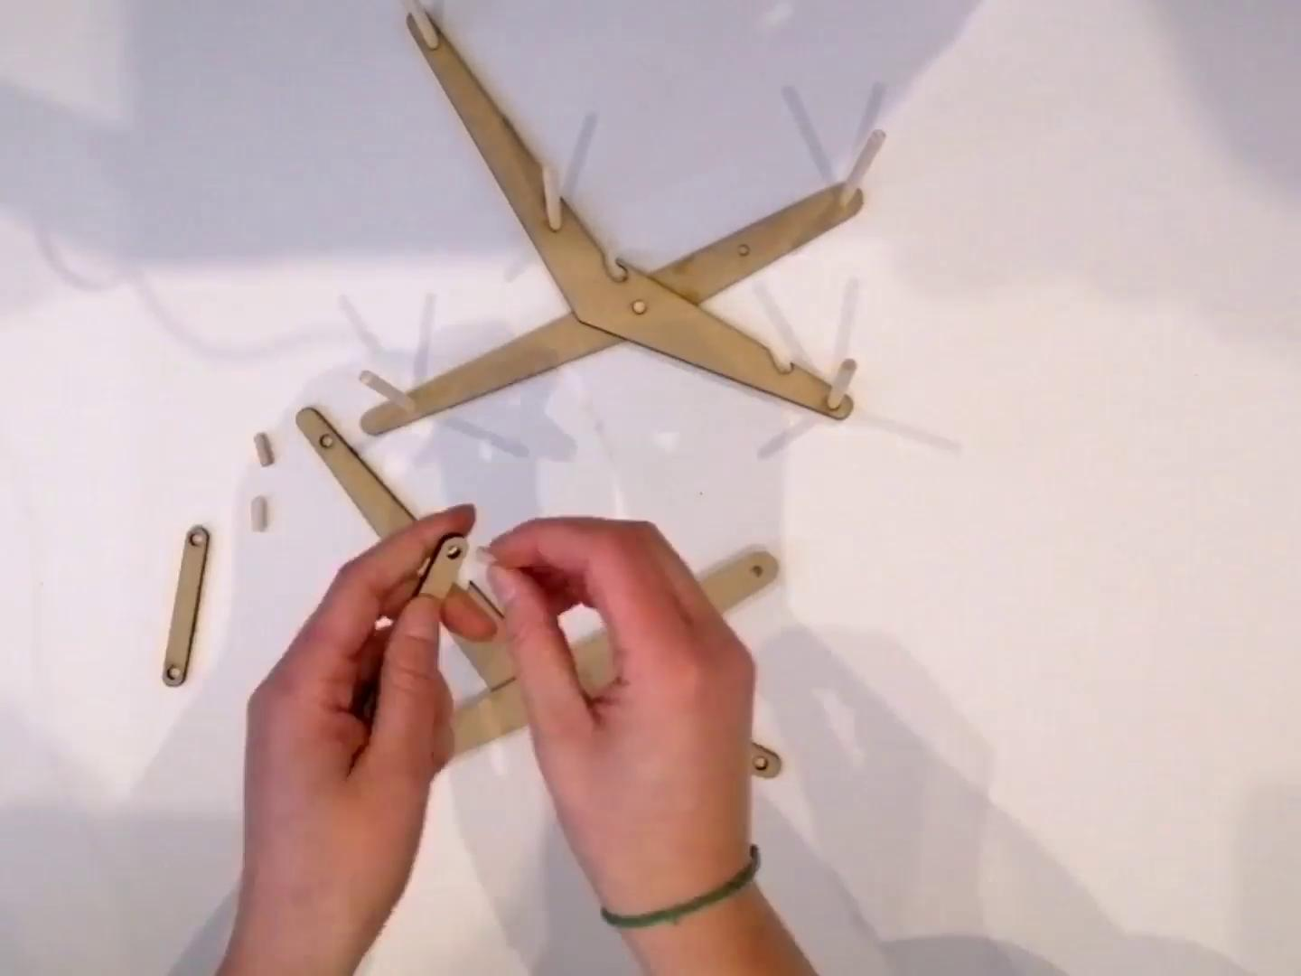

Main Unit

Slide 13
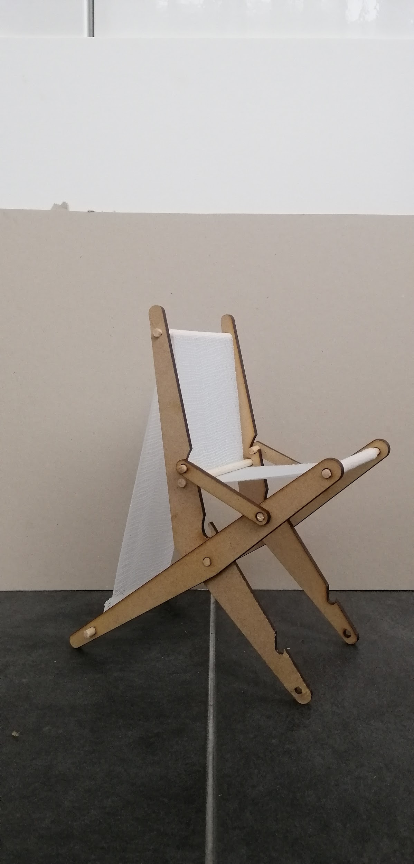
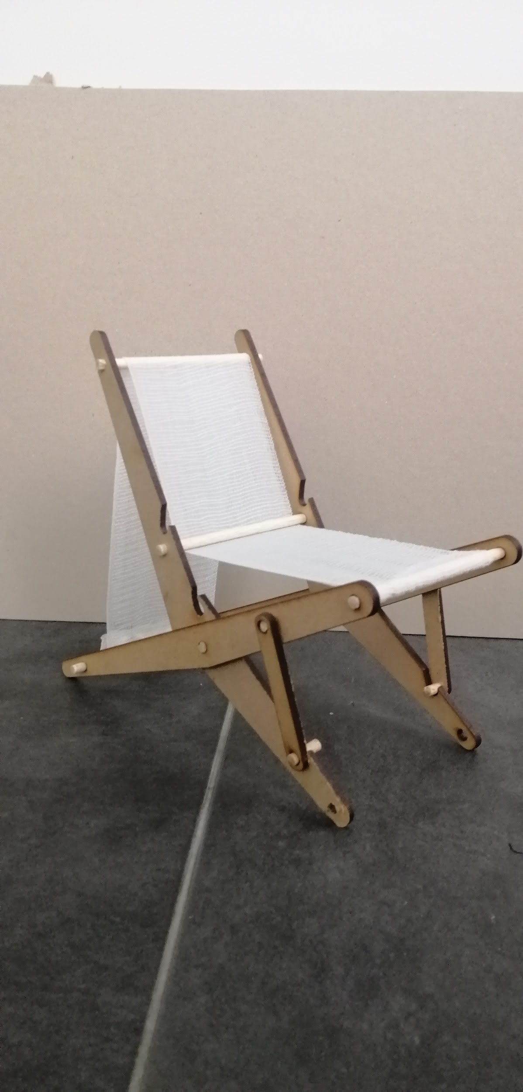
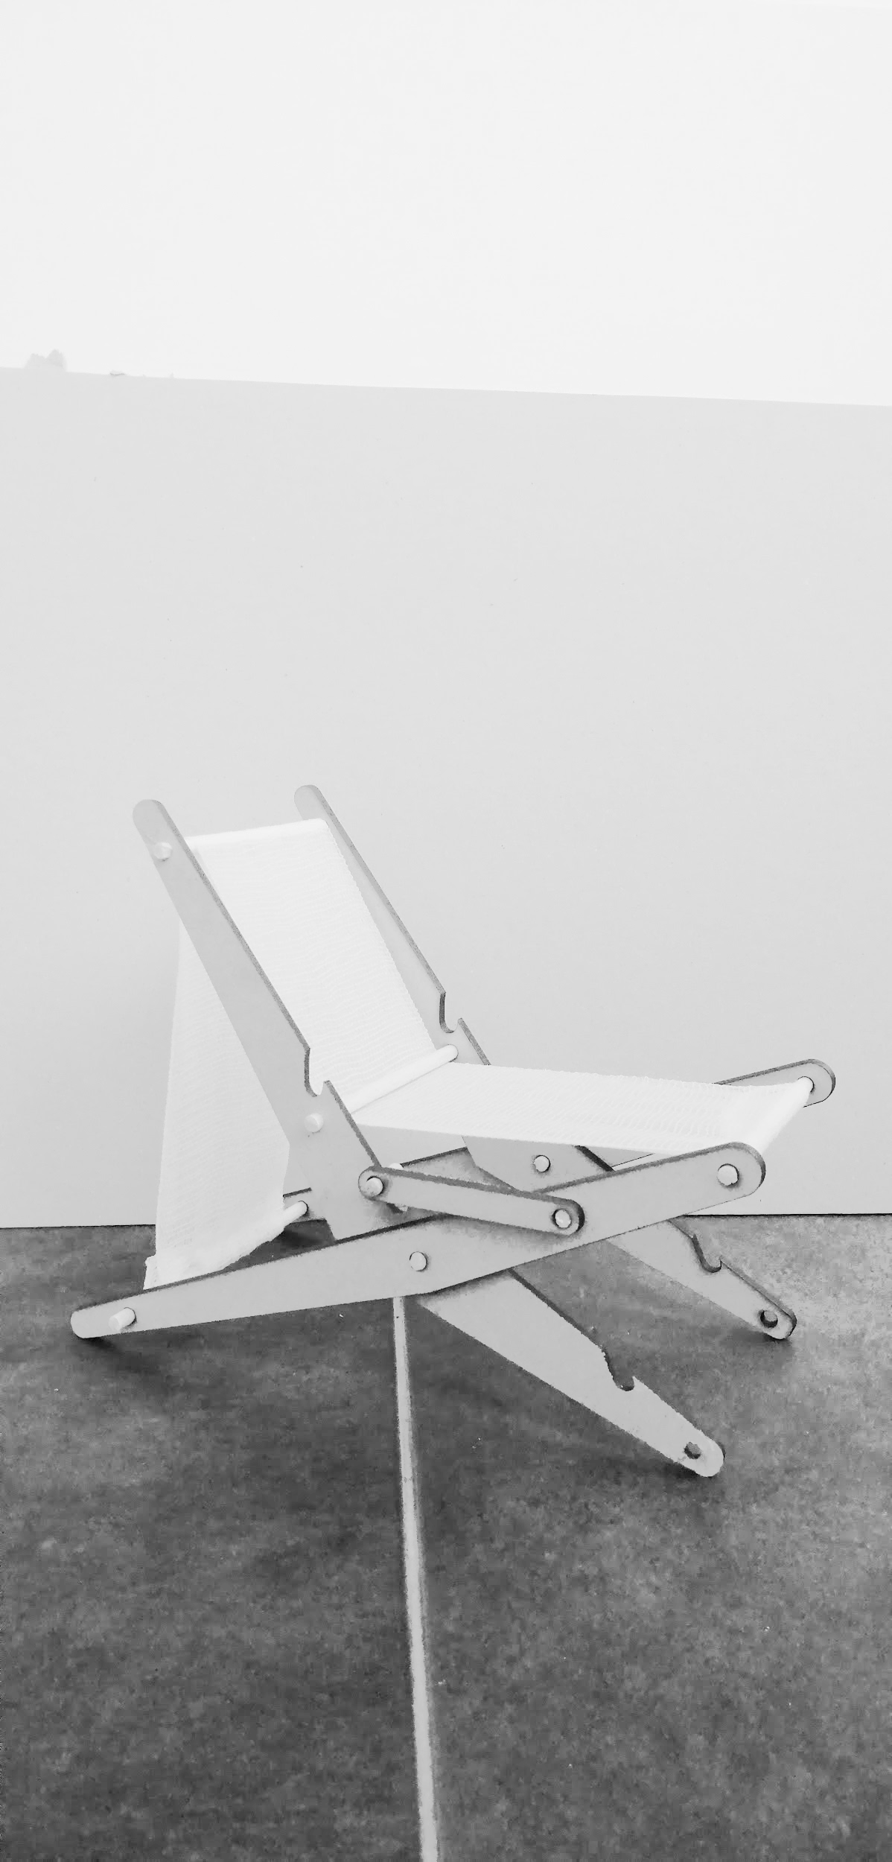


How many alternatives ?
Stool chair
Office chair
Deckchair
1
2
3
Notes:
THE REST VARIATIONS ARE IN THE CONCLUSION, FOR FUTURE
Yup i know . so here you can say. Those are 3 main variations, but the user has to discover the rest himself.
HAHAHAH OKI

Slide 14
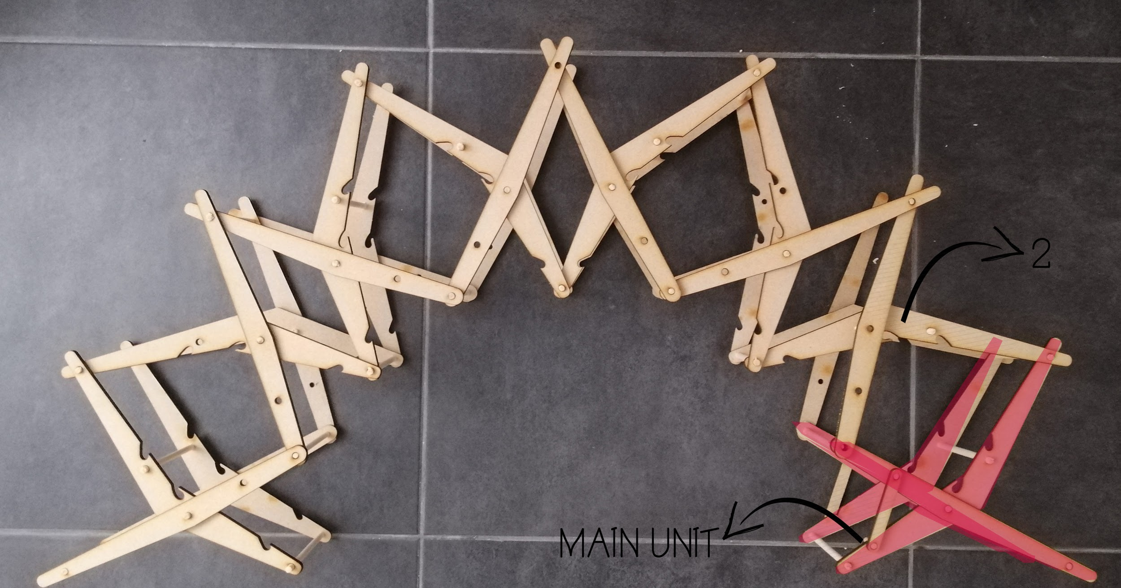
kit-of-parts system - Pavilion
Using the chair as the main unit of constructing the main arch of the pavilion

Slide 15
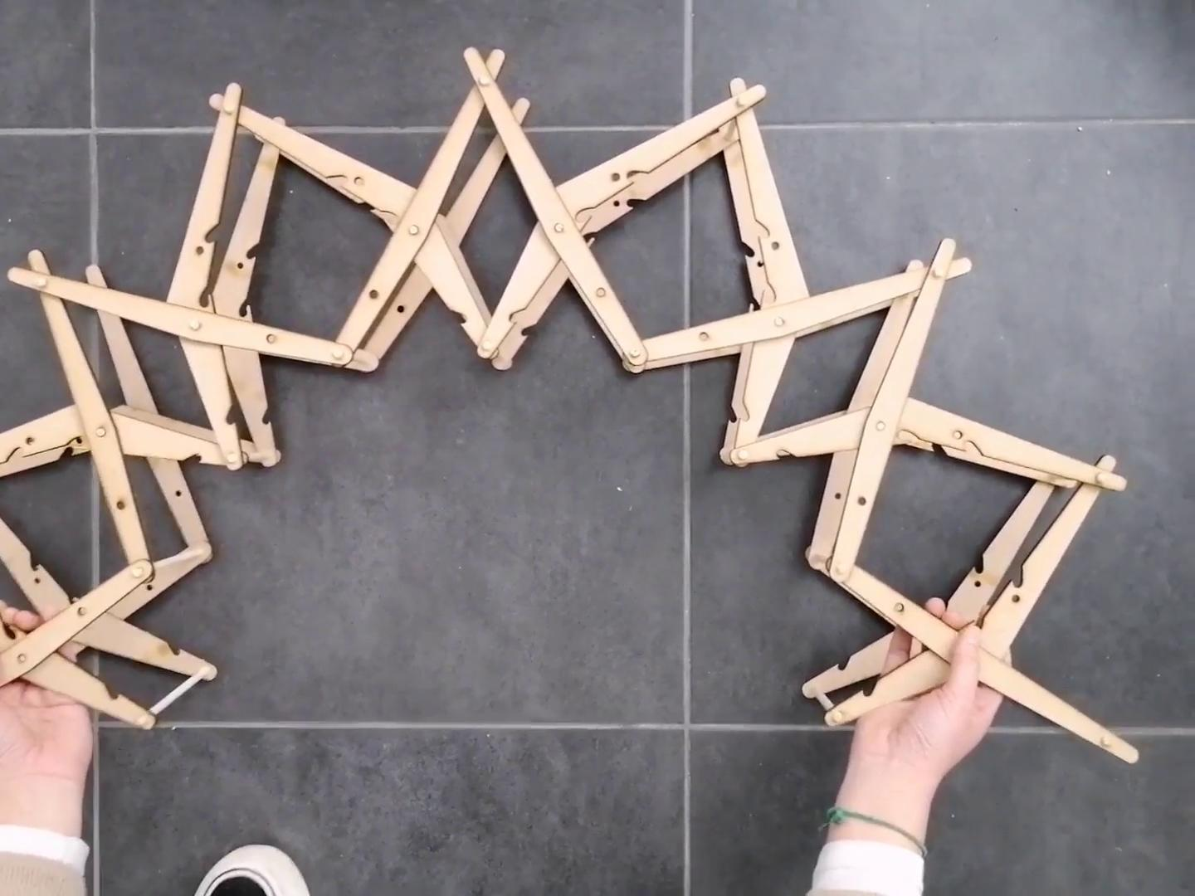
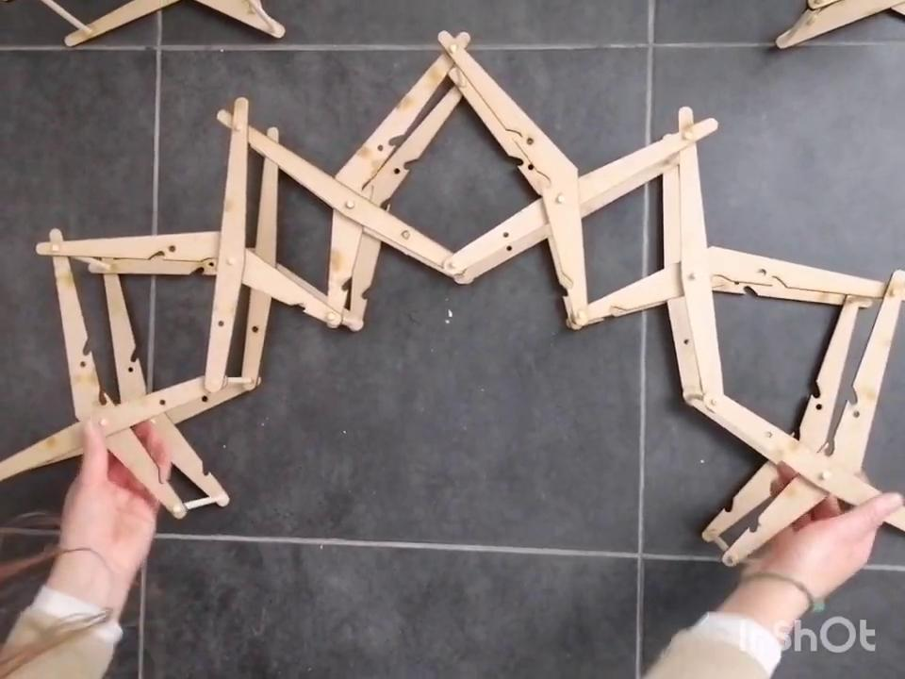
Results and process
With 8 chairs
With 6 chairs
Notes:
Hehe just a comment : ur voice is in the clear in the video. Maybe we should mute it before starting

Slide 16
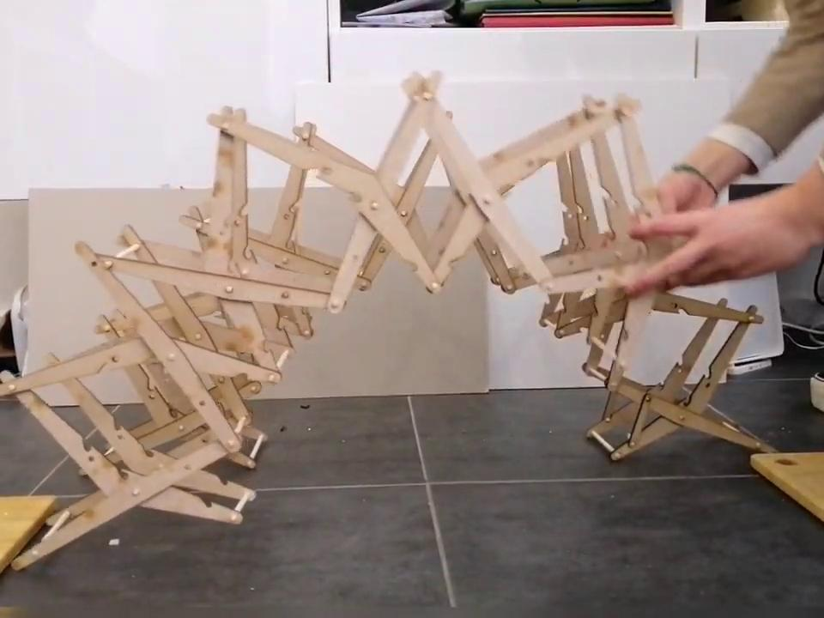
Results and process
Notes:
Hehe just a comment : ur voice is in the clear in the video. Maybe we should mute it before starting

Slide 17
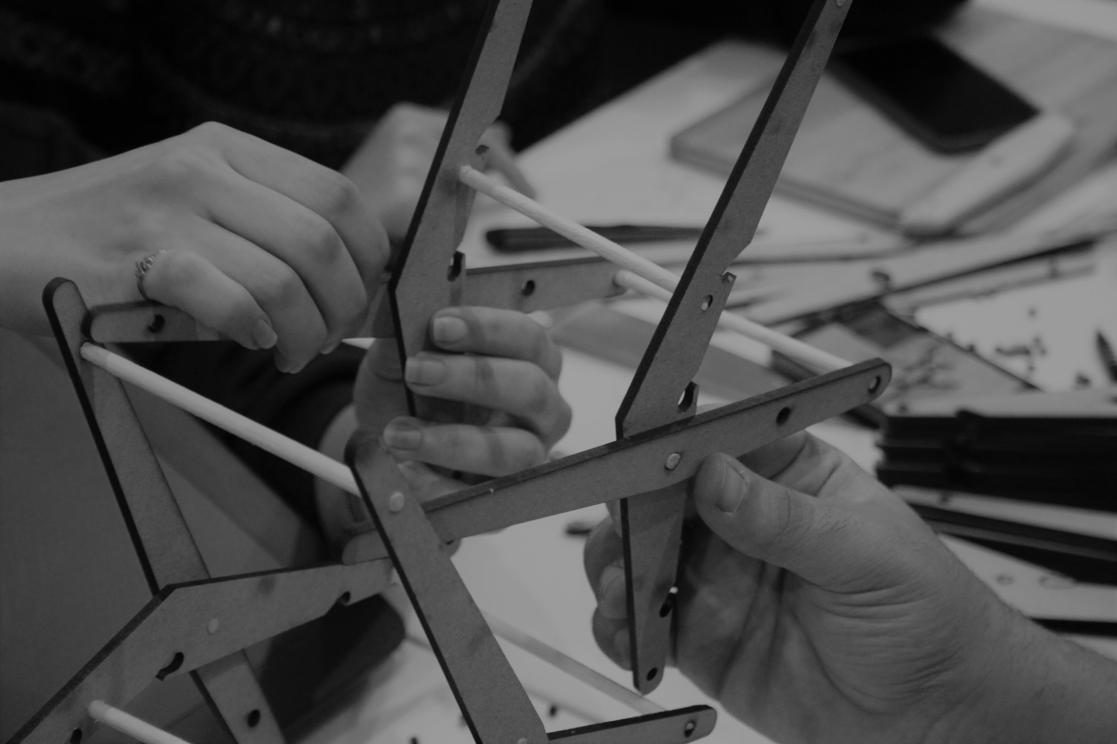
MATERIALIZATION AND DETAILING

Slide 18
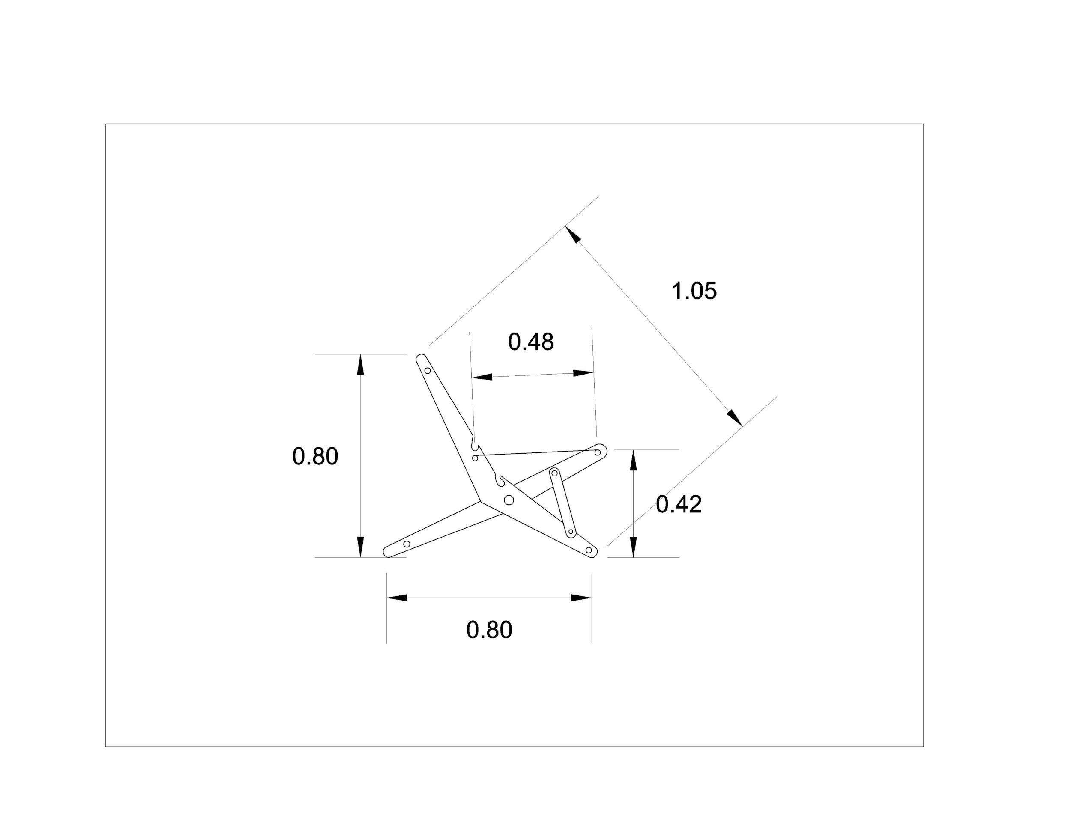
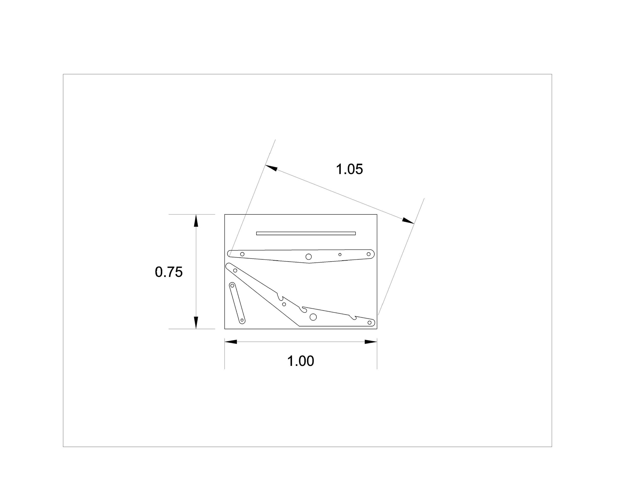
Detailed dimensions
Chair
Box of 1 x 0.75 x 0.65 m

Slide 19
Detailed dimensions
2.50m
1.90m
3.50m

Slide 20
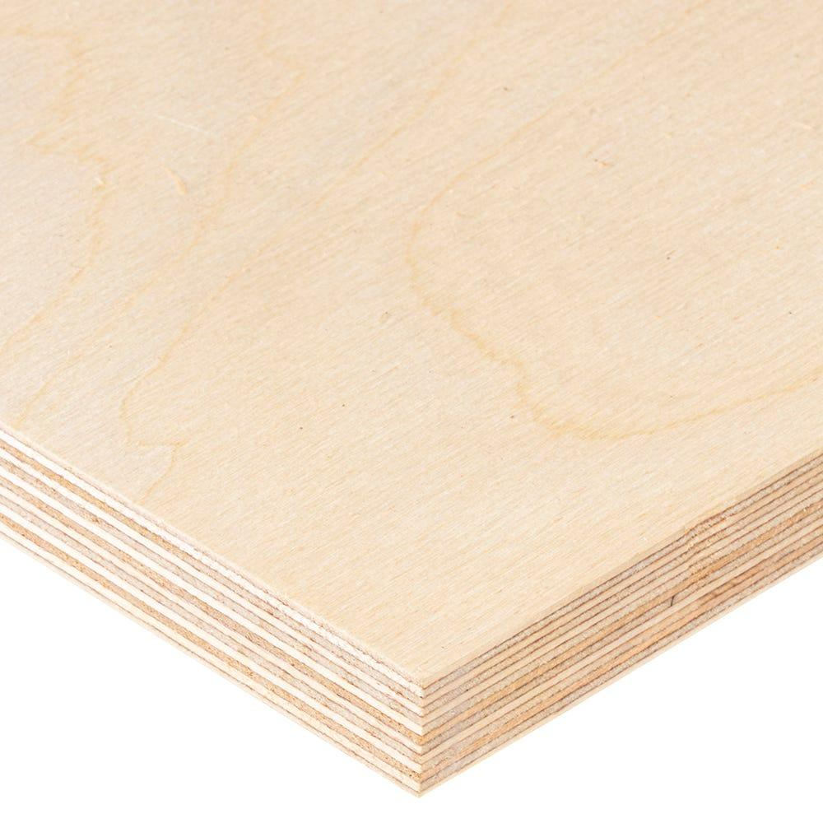
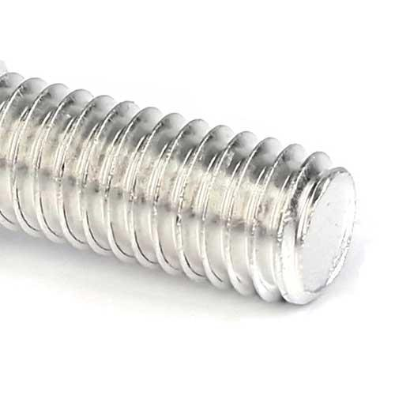

Materials
Birch Plywood frame
Aluminium
Polyester fabric
Strong and lightweight
Safe handling (smooth)
Environmental aspect : fast growing birch trees
Strong and lightweight
Easy to clean and maintain

Slide 21
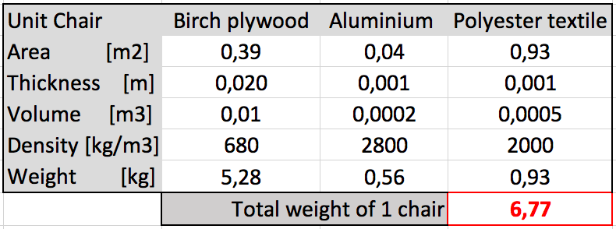
Materials
5 x 6,8 = 34 kg → 5 chairs/box

Slide 22
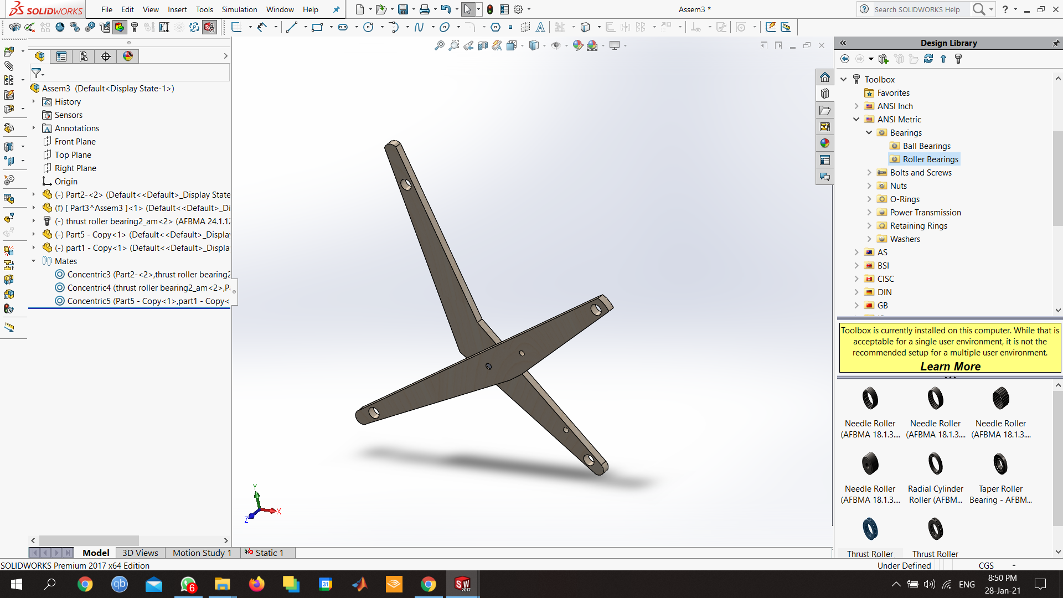
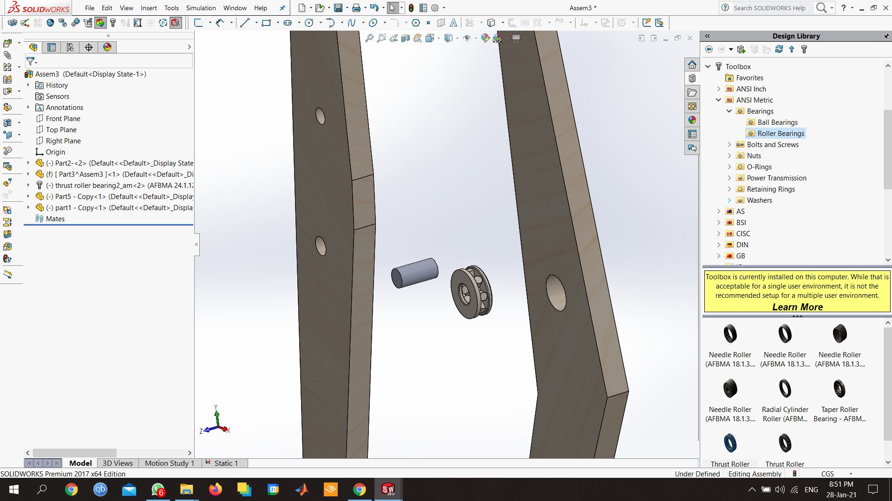
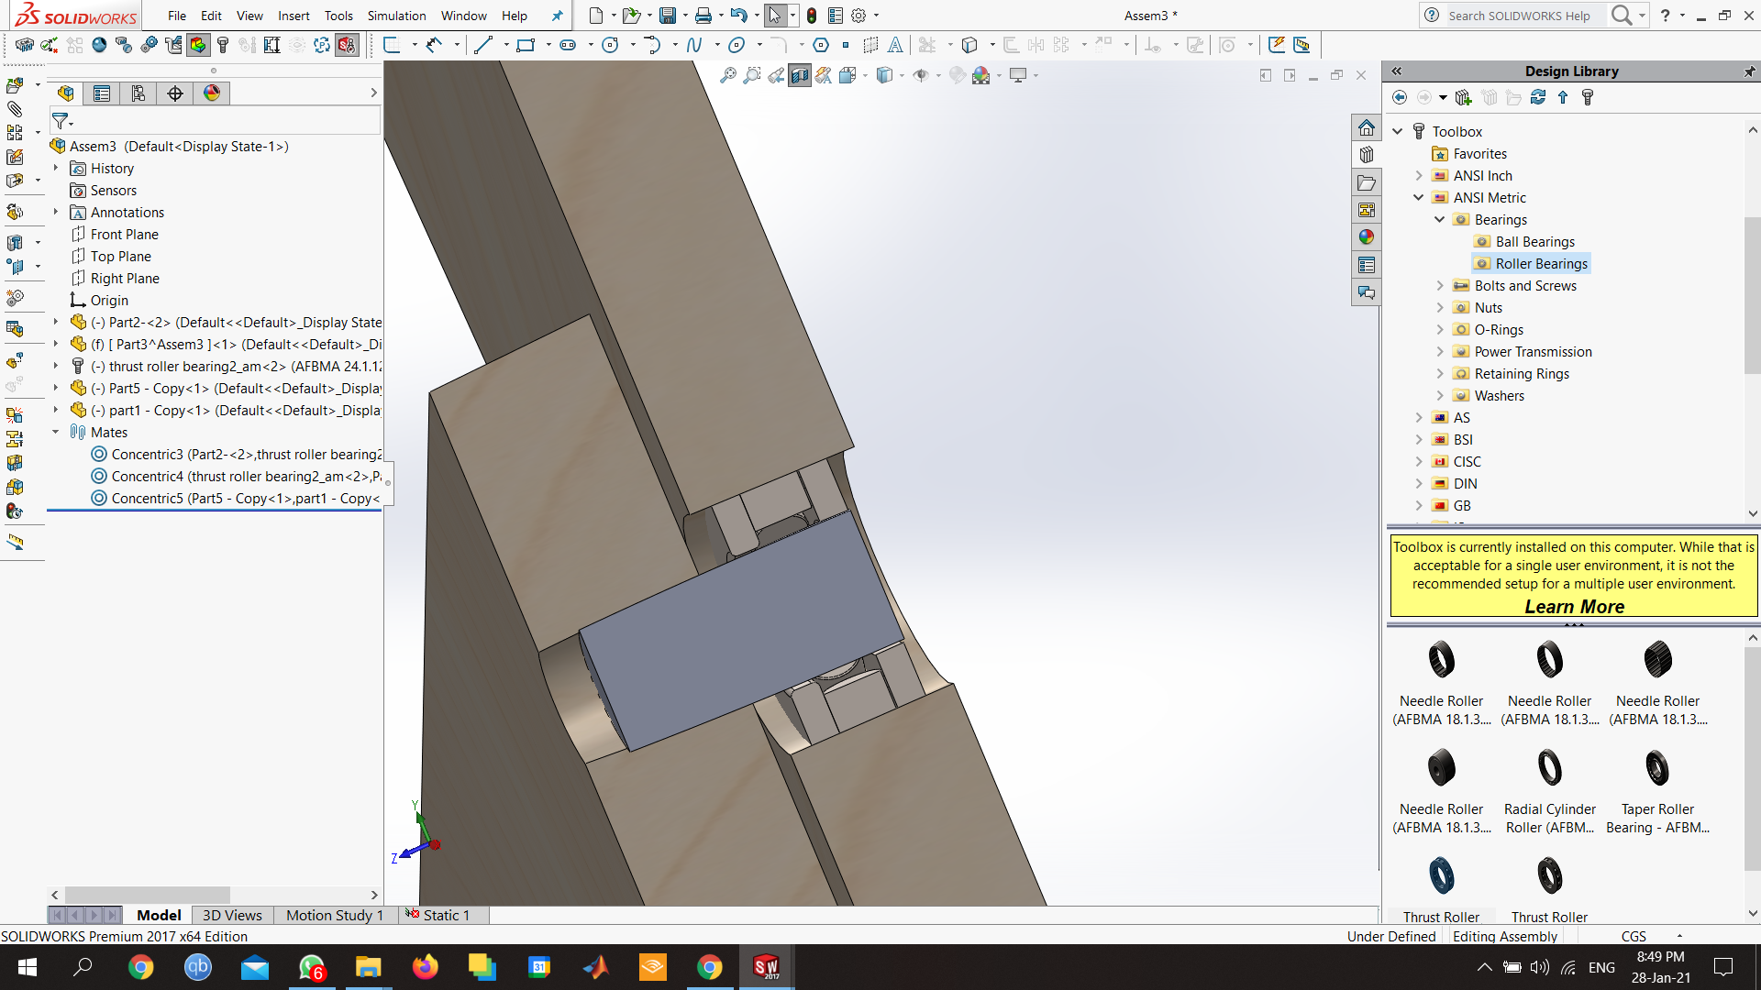
Connections (on Chair)
Bearing

Slide 23
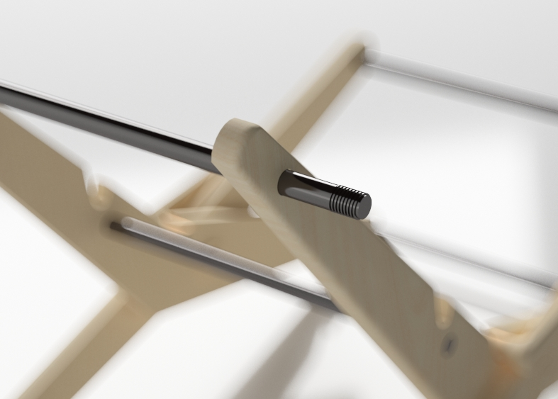
Connections (connecting chairs together)

Slide 24
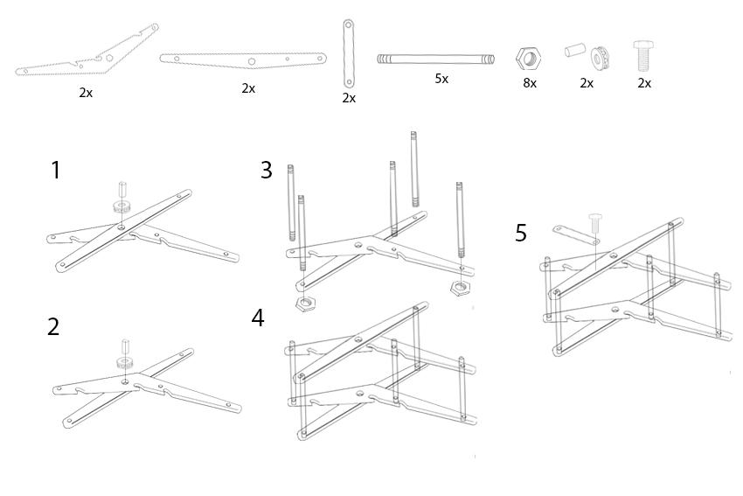
Construction process
Construction process of one chair

Slide 25
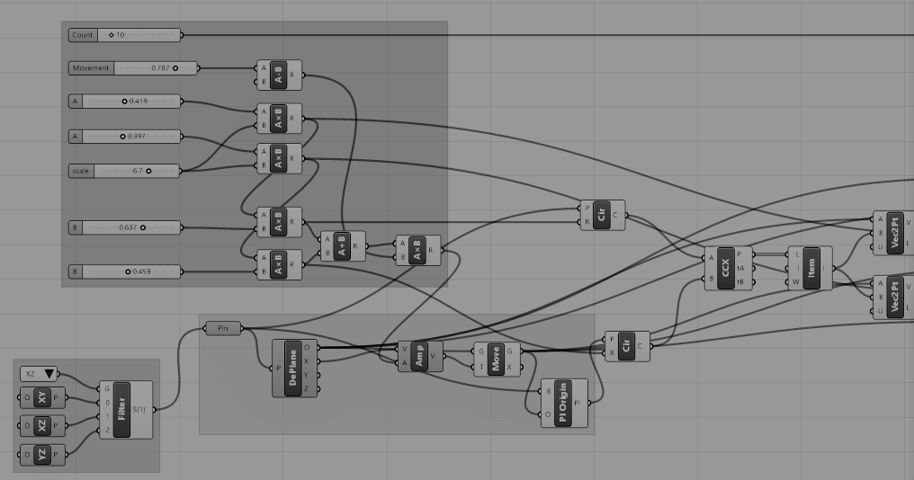
PARAMETRIC TOOLS

Slide 26


Slide 27
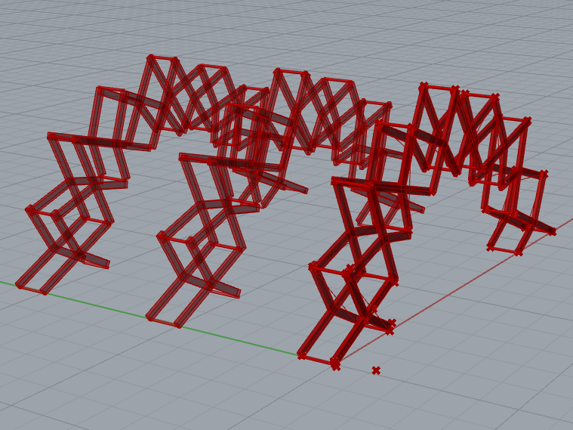
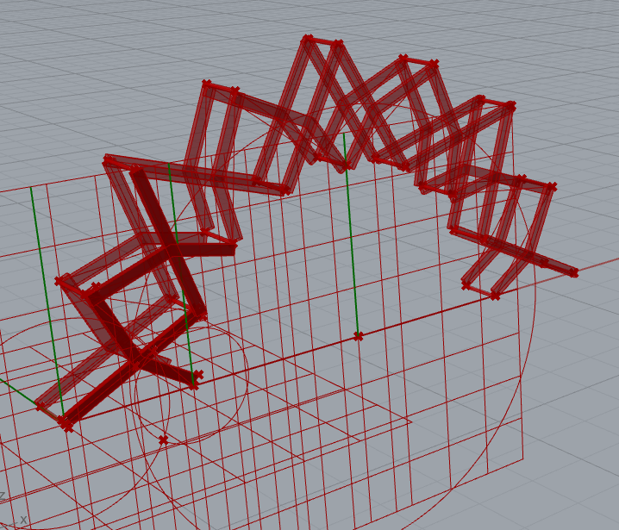
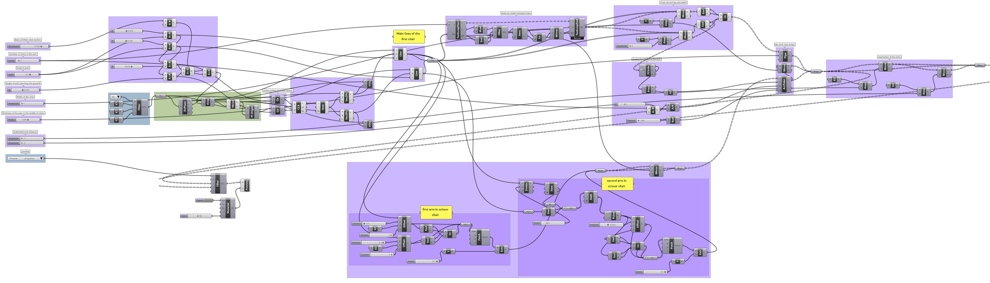
Grasshopper
+
Anemone

Slide 28
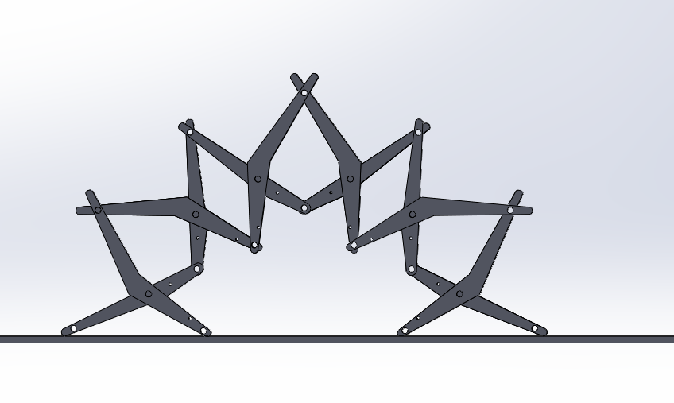
Old but edited the dimensions

Slide 29
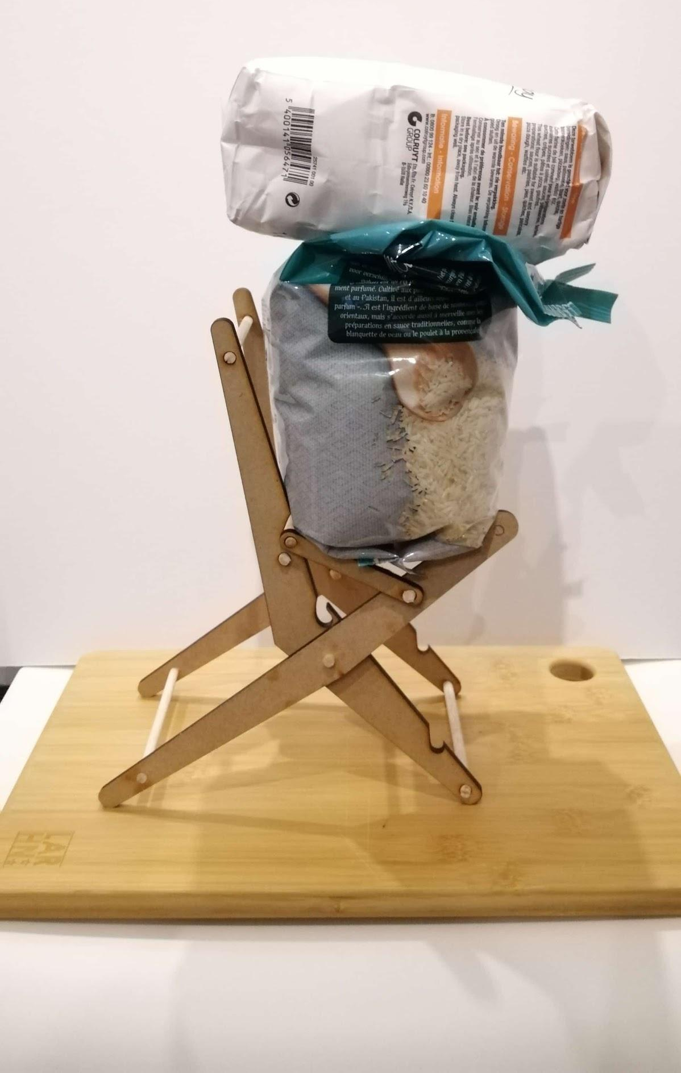
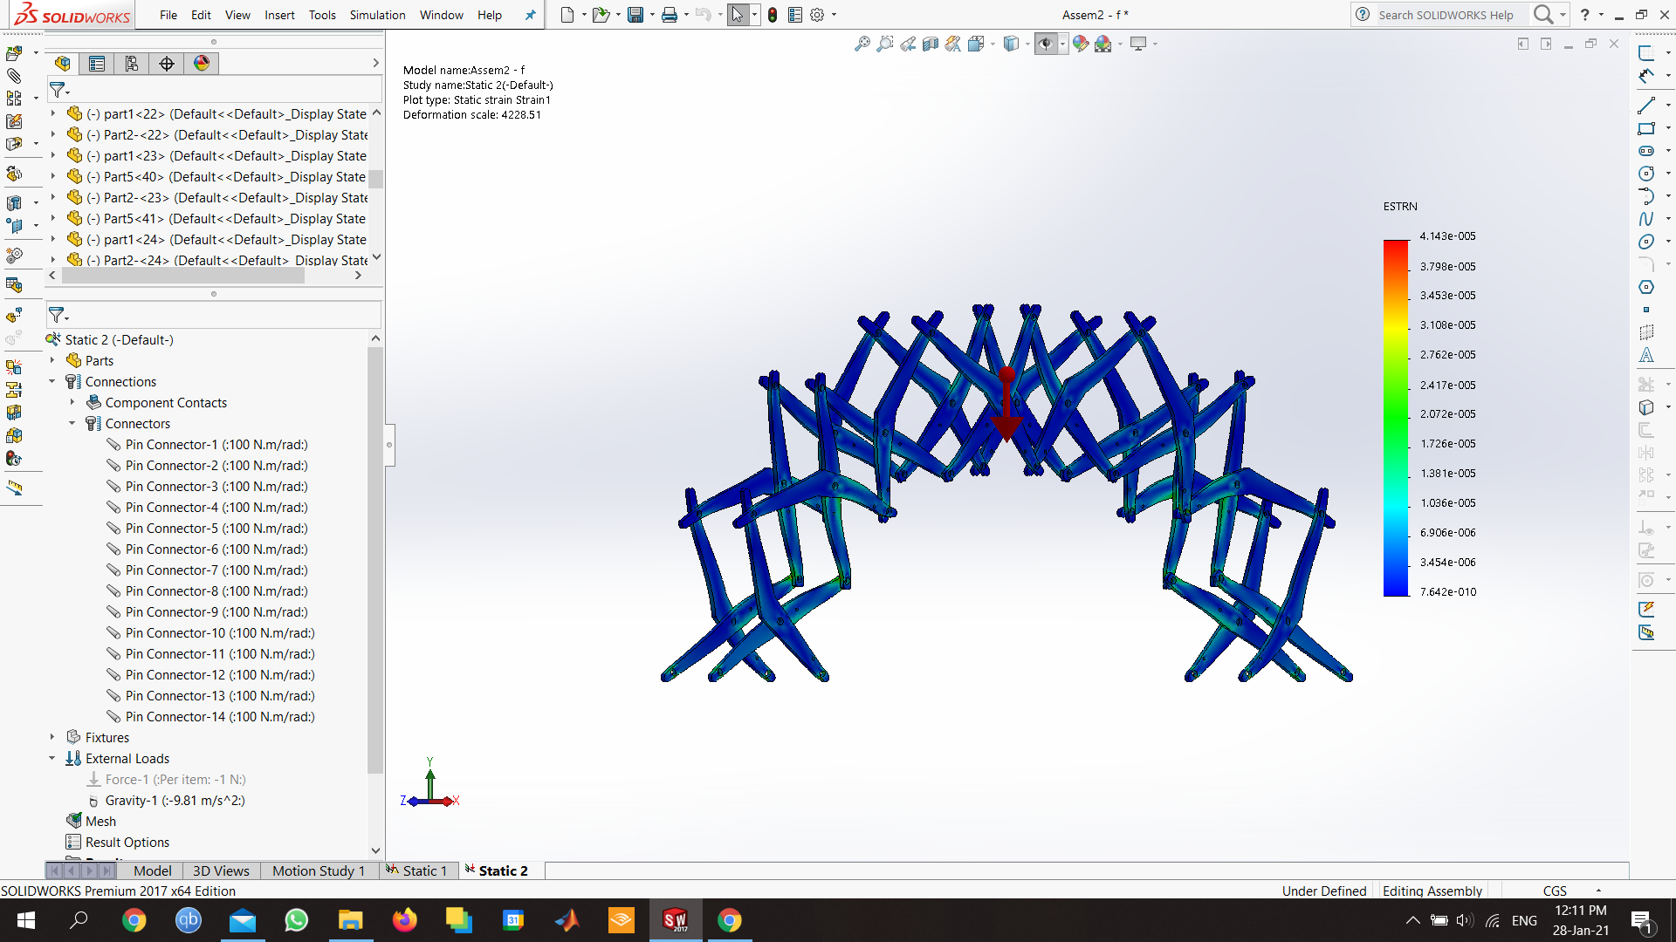
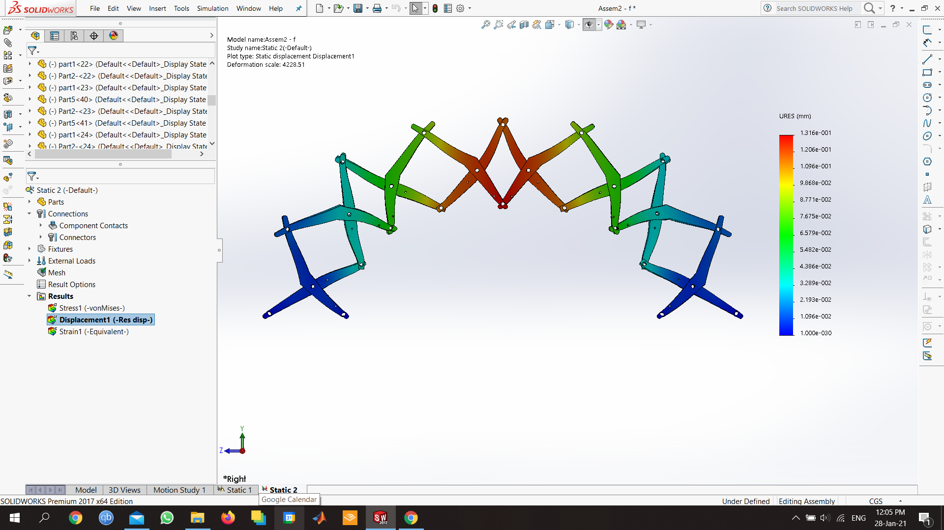
System analysis
Strain
Deformation

Slide 30
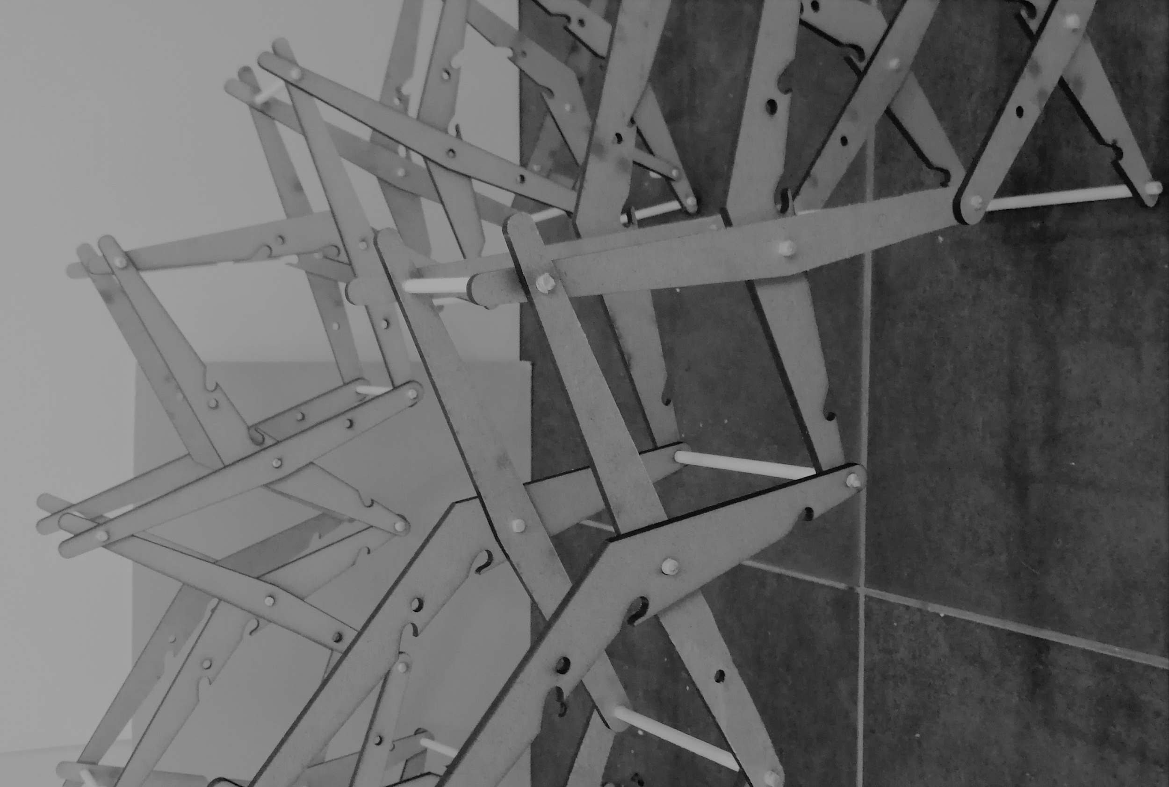
CONCLUSIONS

Slide 38
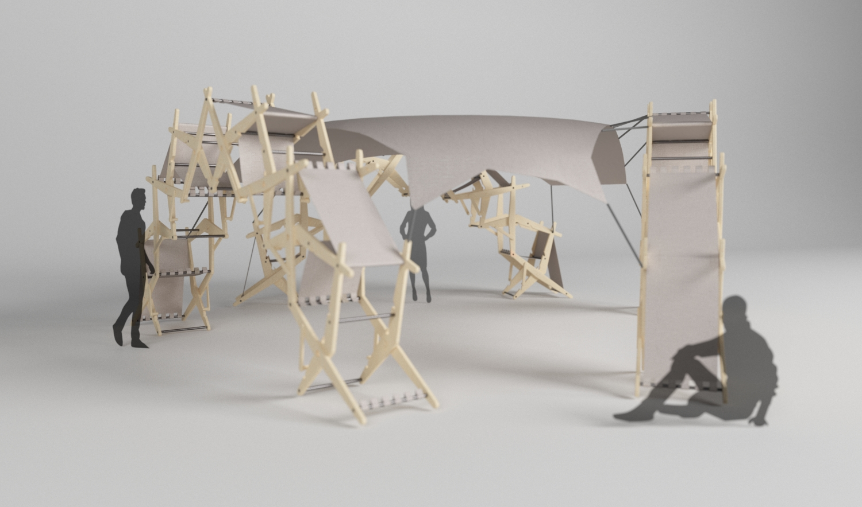

Slide 40
Future development
Connections & joints
Material Development & weight
Deployment
Rotation
More Compactness
Faster Deployment
Exterior Function
Connection to ground
Height of the Pavilion
further structural simulations

Slide 41
Thank you for your attention.
Do you have any questions?

